Slide 1
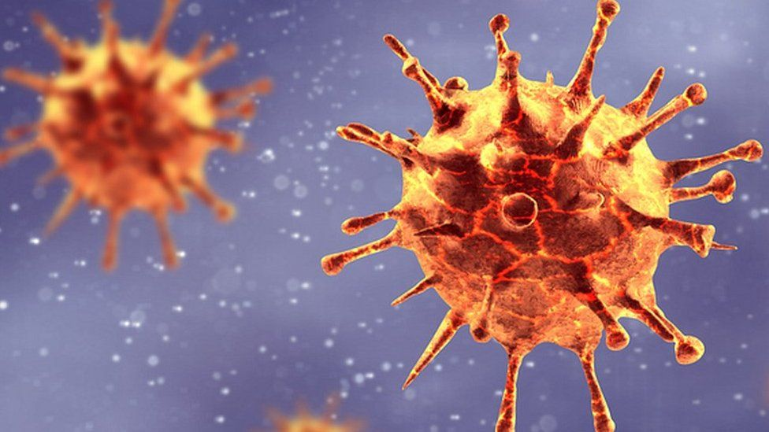
Predicting covid-19 cases in the united states
CAN VACCINATION DATA BE USED TO BUILD A MACHINE LEARNING MODEL THAT PREDICTS THE NUMBER OF DAILY NEW CASES OF COVID-19?
Notes:
Intro: Over the last 2 years, the COVID-19 pandemic has affected millions of lives in the United States and across the world. One of the main debates that arose during the pandemic is the effectiveness and legitimacy of the Covid vaccines that seemed to pop up and get approved within a short span of time. So this project will focus on the potential effect that vaccinations have on the number of new cases in the United States. We try to predict the number of new cases by building a machine learning model using vaccination data, and measure our predictions against baseline models that don’t contain vaccination data. If we can show that our model performs better using vaccination data, then we know that vaccines can be a viable solution to stopping the spread.

Slide 2

data
Notes:
Data: The first step towards building our model is collecting data. In this project, we will be using 2 datasets from Kaggle – one is a list of daily total cases per state, and the other is a list of daily total vaccinations per state.

Slide 3
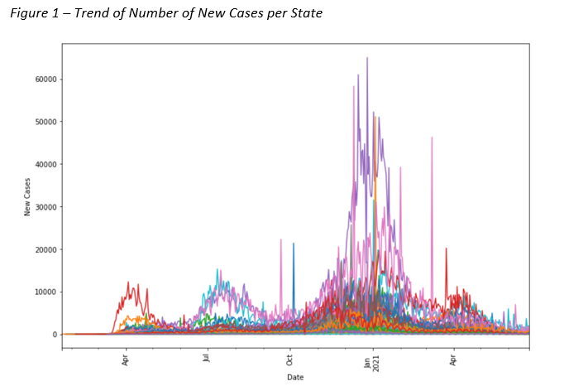
data
Notes:
Data: We take a look at the trend of daily new cases in the US over the last 1.5 years. Each color represents a different state, and even though some states have many more cases than others, there is a common trend in this graph. We see a steep incline of cases towards the end of 2020, and then a decrease at the beginning of 2021, when vaccines begin to roll out.
This increase in cases can be due to increased travel around the holiday season, or evolving lockdown restrictions and mask mandates. But even with the changing landscape, we want to build a model that can show some sort of correlation between the decrease in cases in 2021 and the increase in vaccinations.

Slide 4
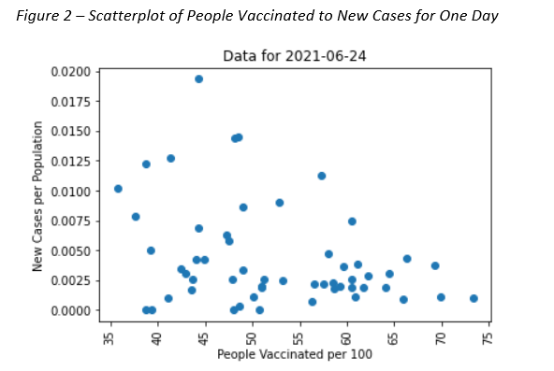
data
Notes:
Data: Here is a scatterplot of the number of people vaccinated against number of new cases for every state on a particular day. The data is normalized to the population of each state to account for the large differences in cases between populated states like New York and California, and some smaller regions like Guam and Virgin Islands.
The scatterplot is relatively random, but you can still see a slight negative correlation between the number of people vaccinated and the number of new cases, showing that vaccinations definitely have an effect on Covid cases.

Slide 5
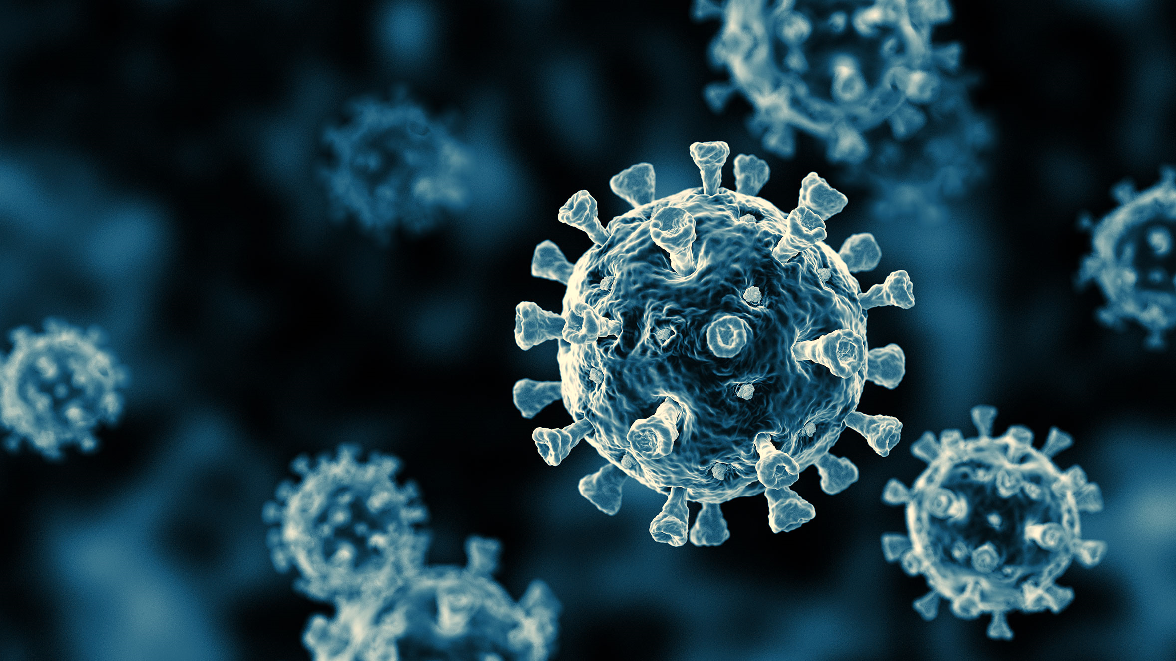
model
Notes:
Model: This project takes a multivariate time series and converts it into a supervised learning model to predict the number of new cases 7 days ahead.

Slide 6
model
DAILY NUMBER OF NEW CASES / HUNDRED
DAILY TOTAL NUMBER OF PEOPLE VACCINATED / HUNDRED
Notes:
Model: For our model, we are only looking at 2 columns from the dataset, the daily number of new cases for every 100 people, and the daily total number of people vaccinated for every 100 people.

Slide 7
model
NUMBER OF NEW CASES 7 DAYS BEHIND
7-DAY ROLLING AVERAGE OF NEW CASES 14 TO 7 DAYS BEHIND
3-DAY ROLLING AVERAGE OF NEW CASES 10 TO 7 DAYS BEHIND
TOTAL NUMBER OF PEOPLE VACCINATED 7 DAYS BEHIND
Notes:
Model: With some feature engineering, we build our 4 input features for the model:
Number of new cases 7 days behind
Rolling average of new cases 14 to 7 days behind
Rolling average of new cases 10 to 7 days behind
Total number of people vaccinated 7 days behind
Our goal is to use these features to predict number of new cases 7 days ahead.

Slide 8
model
KNeighborsRegressor
DecisionTreeRegressor
ExtraTreeRegressor
SVR
AdaBoostRegressor
BaggingRegressor
RandomForestRegressor
GradientBoostingRegressor
Notes:
Model: We split our data into training and testing sets, and fit on multiple regression models from sklearn and use each model to predict the number of new cases. We then calculate the MAE, or mean absolute error, of each model and select the one that has the lowest MAE.

Slide 9
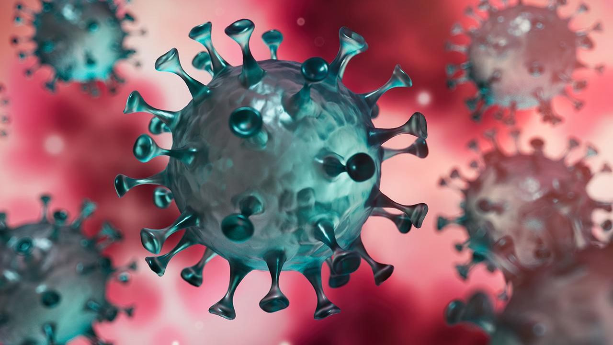
results
Notes:
Results: We found that the Gradient Boosting Regressor model resulted in the lowest MAE. We further decreased this error with some hyperparameter tuning to create our best model.

Slide 10
results
BASELINE MODEL 1:
PREDICTED NUMBER OF NEW CASES =
NUMBER OF NEW CASES 7 DAYS BEHIND
BASELINE MODEL 2:
PREDICTED NUMBER OF NEW CASES =
GRADIENT BOOSTING MODEL USING:
NUMBER OF NEW CASES 7 DAYS BEHIND
7 DAY ROLLING AVERAGE OF NEW CASES 14 TO 7 DAYS BEHIND
3 DAY ROLLING AVERAGE OF NEW CASES 10 TO 7 DAYS BEHIND
Notes:
Results: In order to evaluate performance, we created 2 baseline models, one dummy model that assumed new cases at time t is equal to new cases at time (t-7), and another ML model that had all the same parameters as our best GBR model except without the vaccination data. Interestingly, the MAE for the machine learning model was larger than the MAE of the dummy model, causing us to go back and revisit our approach.

Slide 11
results
TRAINING SET
TESTING SET
FULL DATASET
Notes:
Results: We realized that there is a significant difference between the training and testing set (most likely due to the absence of vaccination data prior to 2021, and the large fluctuation of new cases towards the end of 2020 and beginning of 2021), that we don’t see in the testing data. For this reason, we decided to combine the training and test sets into one dataset and fit and predict on the same dataset.

Slide 12
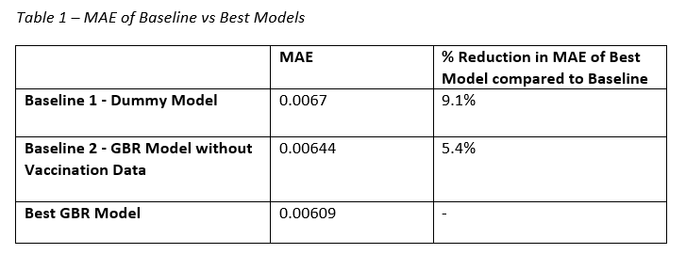
results
MACHINE LEARNING MODEL REDUCED ERROR BY 9.1%
VACCINATION DATA REDUCED ERROR BY 5.4%
Notes:
Results: In order to prevent overfitting, we use the same hyperparameters that were determined earlier in our best GBR model. This table shows the MAE of the 3 models. Comparing our best model to the dummy model, we can see that our machine learning model reduced error by 9.1%. When we isolate the effect of including vaccination data into our model, we see that the inclusion of vaccination data reduced error by 5.4%.
As a frame of reference, when we compare the MAE of our best model to the average new cases per hundred in the dataset, we get approximately a 30% error rate, which is relatively high. This can be due to the fact that there are many other factors that affect the number of daily cases that have not been accounted for in the model.

Slide 13
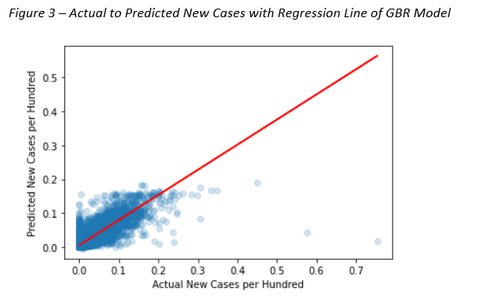
results
Notes:
Results: When we plot the actual new cases to predicted new cases from our best model, we get a positively correlated scatterplot, where the slope of the regression line is 0.74. This shows that our predicted values are pretty close to the actual numbers, with some outliers affecting the performance.

Slide 14
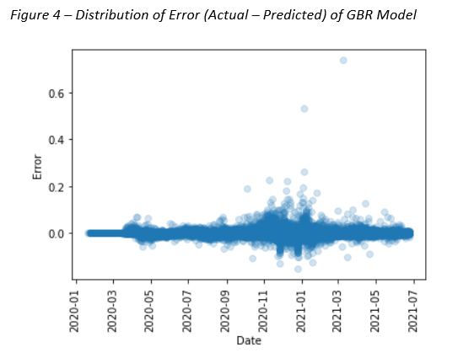
results
Notes:
Results: We also plot the distribution of the error of our model, and see that it is centered around 0, with some outliers on the positive x-axis.

Slide 15
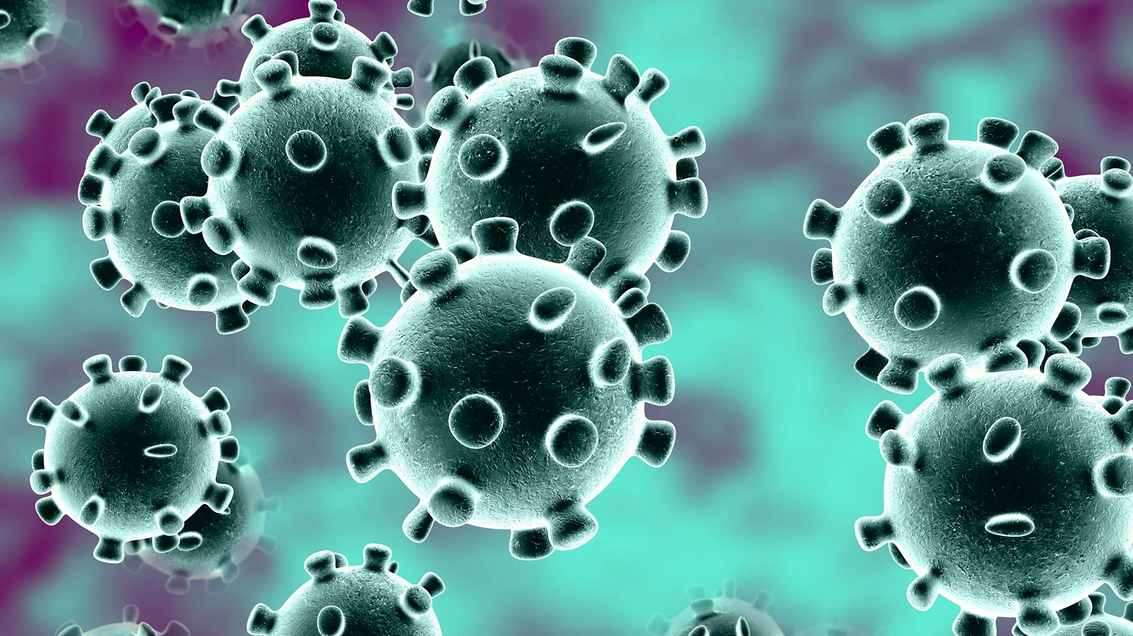
conclusion
Notes:
Conclusion: From our Gradient Boosting Regressor model, we see that there is in fact a correlation between the number of people vaccinated and the number of new cases in the United States. Comparing the two baseline models to our best performing model, we see a significant improvement when vaccination data is added. Although overall error values are relatively high, this can be due to the various factors that determine the number of new cases that fall outside the scope of this project, including travel restrictions, lockdown policies, and Delta and more recent variants.
Overall, our findings conclude that vaccinations do have an effect on the number of Covid-19 cases in the United States.

